Slide 1

Welcome to Priory Surgery
Tel: 0117 949 3988
www.priorysurgerybristol.co.uk

Slide 2

Your Named GP
In December 2023
We provided over
4540
Overall appointments

Slide 3
Breakdown of appointments offered
GP’s/ANP/Trainee doctors and student doctors – 2083
Nursing/Chronic Illness reviews - 1968

Slide 4
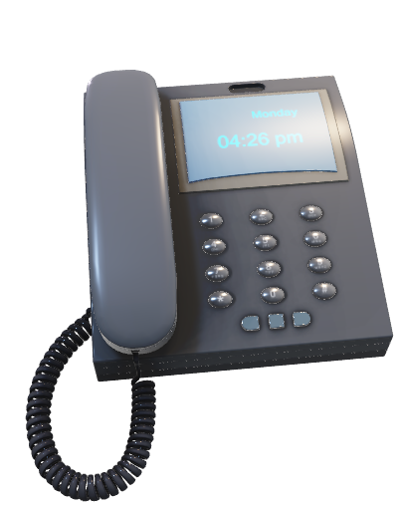
In December 2023
We handled over
6801
Telephone calls

Slide 5
Call Figures from December 2023
We took 6801 telephone calls
Average time in real queue – 32 seconds (after call back was cleared)
Average time in call back queue – 26 minutes 40 seconds
1426 Patients hung-up/abandoned call before we could answer

Slide 6
Your Named GP
We offered PCN Appointments
Physio – 45
Mental Health and Wellbeing coach – 178
Social Prescriber – 67

Slide 7
In December 2023
157
Patients did not attend their booked appointments

Slide 8
DNA’s for November 2023
GP’s – 22
Nursing staff – 119
PCN - 16

Slide 9
Impact of Missed Appointments
Demand for appointments is very high, and whilst we are aware that there are some circumstances which can make a missed appointment inevitable, their impact can be significant, leading to:
  An overall increase in waiting times
  Frustration for both staff and patients
  A waste of resources
  A potential risk to the health of other patients because of the above
We would therefore politely request patients to contact the surgery and let us know, if you are unable to attend your appointment.

Slide 10

Tel: 0117 949 3988
www.priorysurgerybristol.co.uk

