Slide 1

Welcome to Priory Surgery
Tel: 0117 949 3988
www.priorysurgerybristol.co.uk

Slide 2

Your Named GP
In October 2023
We provided over
6661
Overall appointments

Slide 3
Breakdown of appointments offered
GP’s/ANP/Trainee doctors and student doctors – 2625
Nursing/Chronic Illness reviews - 3666

Slide 4
In October 2023
223
Patients did not attend their booked appointments

Slide 5
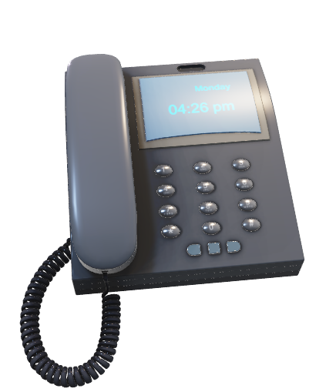
In October 2023
We handled over
15,807
Telephone calls

Slide 6
Call Figures from October 2023
We took 15,807 telephone calls
Average time in real queue – 1 minutes 6 seconds
Average time in call back queue – 34 minutes 29 seconds
774 Patients hung-up/abandoned call before we could answer

Slide 7
Your Named GP
We offered PCN Appointments
Physio – 57
Mental Health and Wellbeing coach – 110
Social Prescriber – 79

Slide 8
DNA’s for October 2023
GP’s – 29
Nursing staff – 160
PCN - 11

Slide 9

Tel: 0117 949 3988
www.priorysurgerybristol.co.uk

